Slide 1


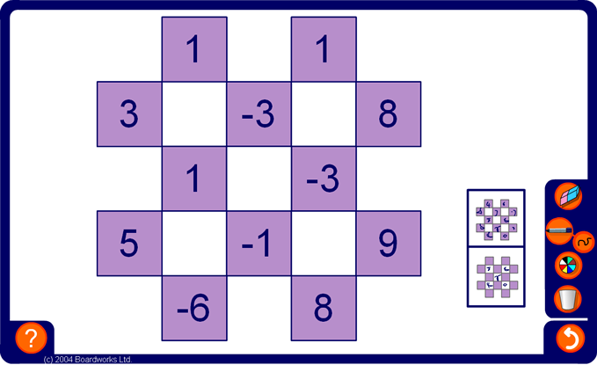


Chequered sums
Notes:
Explain that the numbers in the white squares are equal to the sum of the numbers in the four coloured cells touching them.
Explain clearly how to work out the answer in one of the squares.
Now ask pupils for the number which goes into each square.
Pupils may give their answers using individual white boards or by putting hands up.
Make the activity more difficult by hiding integers in the coloured cells.

